Slide 1
Purdue BAZAAR “Your Purdue Community, Your Marketplace Home.”
GROUP- 11
- Sri Naga Sai Subhank Vempati
- Mohin Pasha Mohammad
- Swarnavo Chakrabarti
- Varun Kumar Valaboju

Slide 2
Outline
Project overview
Functional requirements
Non-functional requirements
Nice-to-have requirements.
System models
System architecture

Slide 3
Project Overview
Welcome to our Purdue marketplace, where Mastodon’s connect, trade, and grow. We're all about fostering community, convenience, and collaboration. Join us in making your Purdue experience even better.

Slide 4
Functional Requirements
1. User Login page: Authorization of user.
2. Passwords saved will be encrypted, so basically, encryption and decryption of passwords for securing sitting passwords in Database.
3. Forgot password: In case, user (account already created) forgets his passwords. Now, user can reset his password with this functionality.
4. Create new account: New user profile will be created.
5. User profile: Setup database for user credentials, addresses, and contact information.
6. Search bar option: Will help users to look-up products with ease.
7. Product categories: Products will be categorized for convenience to find same kind of products.

Slide 5
Functional Requirements contd..
8. Ratings database for user to give product specific feedback and rating on a scale of [1-5] *1 Bad review; *2 Not Satisfied; *3 Satisfied; 4* Good; *5 Excellent.
9. Filter for products (UI): Users can be able to sort products using the below options:
- Price high – low
- Popularity based on ratings.
10. Order cart: Implement carting option for users to group different products and buy them at once or remove them if needed from cart.
11. Orders placed notification! – Email notification for user/customers who have placed their order(bought).
12. Pagination – Pages for Website to look-up for more products instead of scrolling forever. Basically, 3 - 5 products per page only.

Slide 6
Non-Functional Requirements
1. Authentication for all GET, POST, PUT, DELETE calls.
- Username: user
- Password: password
With Basic Authentication
2. Rate Limiting and Throttling:
a. Rate Limiting: Implement rate limiting to prevent abuse of your API and ensure fair usage.
b. Throttling: Apply throttling to control the number of requests a client can make within a given time frame.
GET all or POST request on rating API calls
3. Documentation:
API Documentation: Provide clear and up-to-date documentation for the API, including endpoints, request/response formats, and usage examples.

Slide 7
Non-Functional Requirements contd..
4. Performance: Response Time: Ensure that the API responds quickly to client requests to provide a smooth user experience.
Response time less than 500 ms
5. Authorization: Define access controls and permissions to restrict what authenticated users can do within the API.
6. Error Handling: Implement proper error handling and logging to aid in debugging and troubleshooting.
7. Test Automation: Implement automated testing to catch regressions and issues early in the development process.

Slide 8
Must have requirements
Account Creation
User authentication and authorization
User Profile
Add to Cart
Product Catalog
Final Order Page

Slide 9
Nice to have Requirements
Password Retrieval (Forgot Password)
Product Search
Product filter based on:
Price
Ratings
Categories
4. Pagination
5. Email Notification
6. Order history

Slide 10
System models

Slide 11
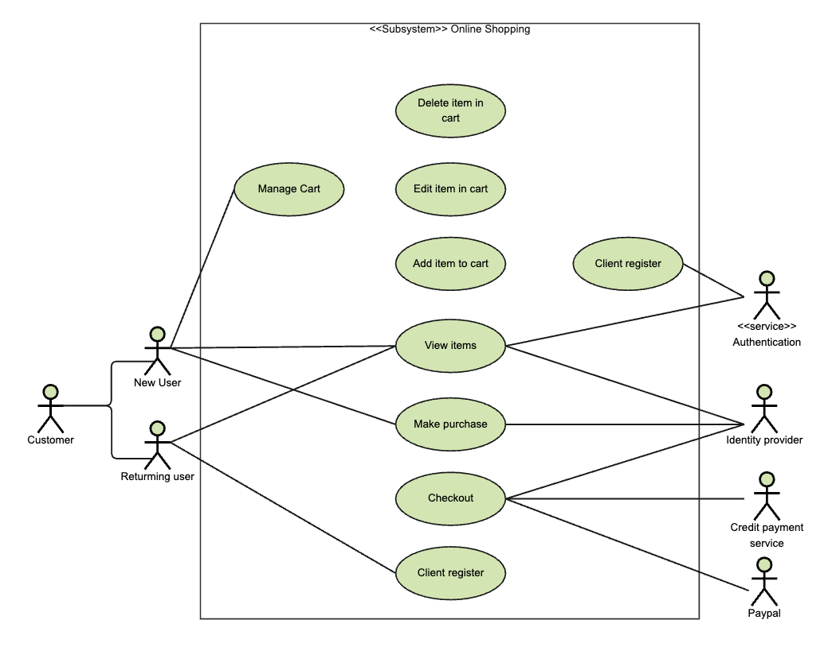
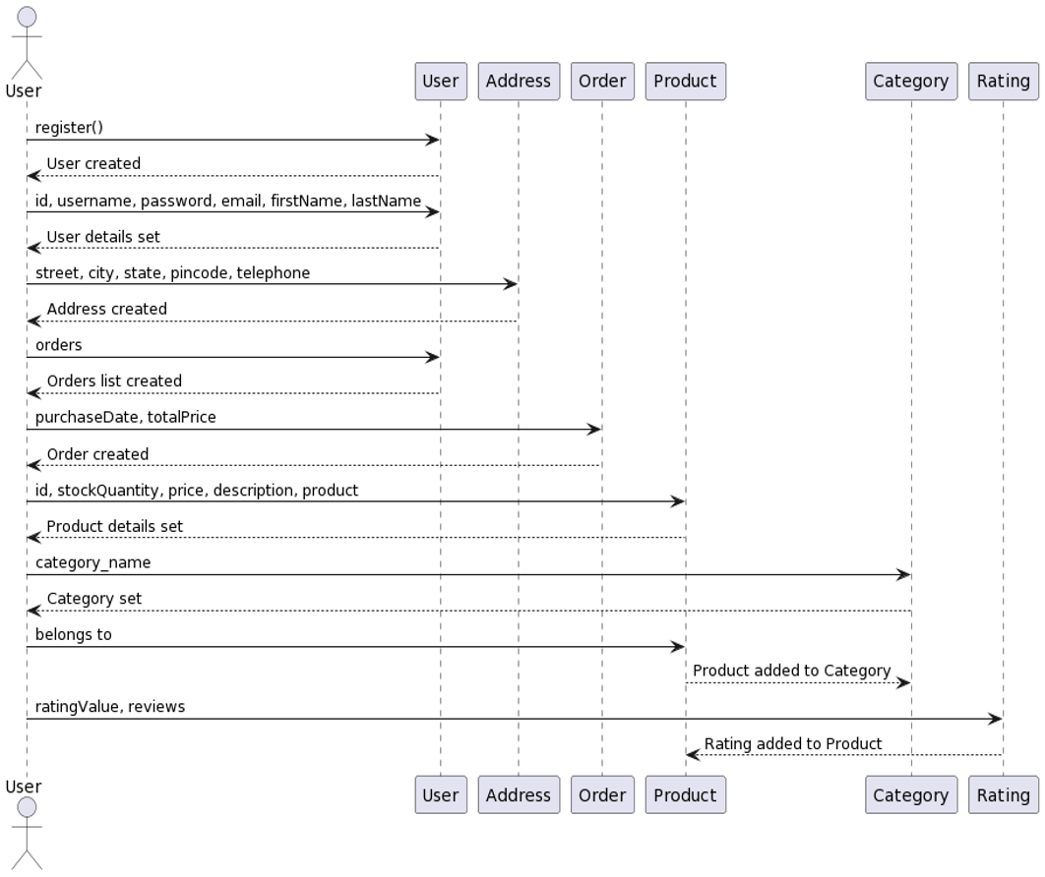
USE Case and sequence diagram

Slide 12
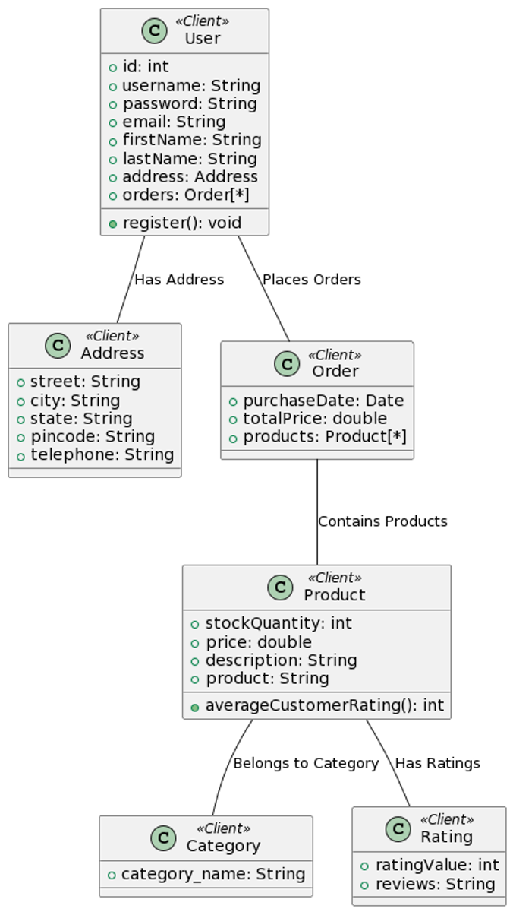
Client CLASS DIAGRAM

Slide 13
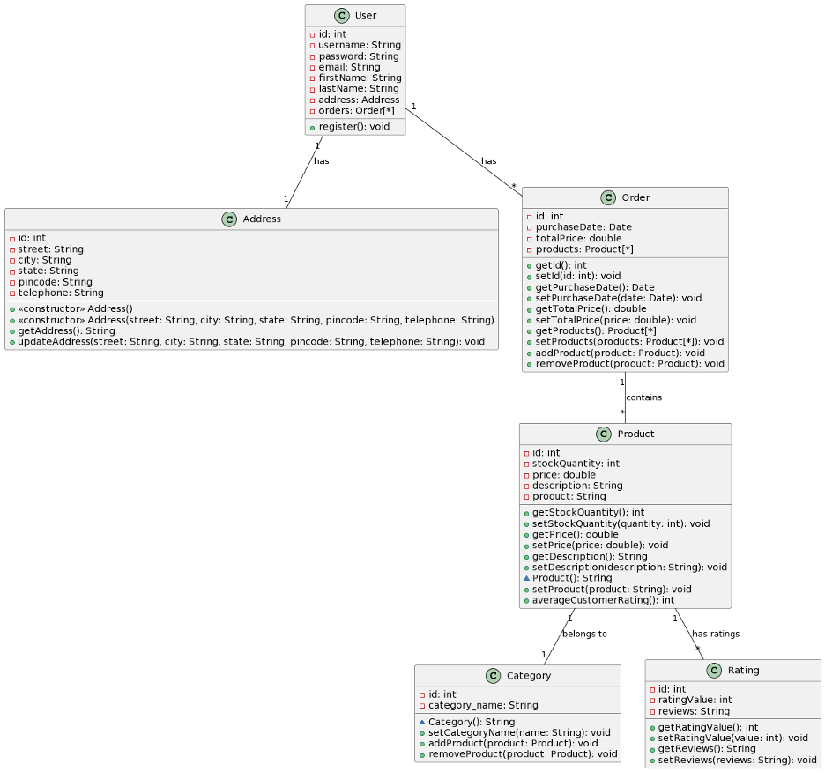
Server CLASS DIAGRAM

Slide 14
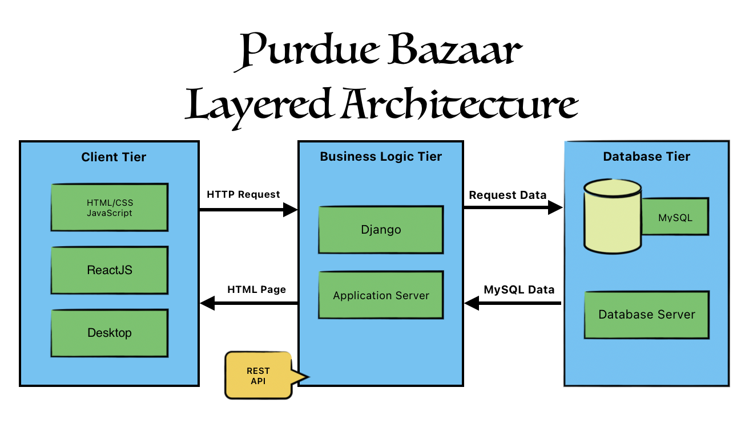
SYSTEM ARCHITECTURE (LAYERED)

Slide 15
testing
Manual Testing
Test scenario identification
Test cases identification
Test case execution
Automation Testing (Proposed)
UI and functionality automation using Selenium with python

